Slide 1



ON SPOT
AUTOCARE
Presented by: Optivora

Slide 2






OUR TEAM
R.M.V.P.B.
Udagama
L.G.R.J.
Lindapitiya
L.G.K.G.
Lindapitiya
Leader
Team Member
Team Member

Slide 3

OVERVIEW
01
02
03
Problem Definition
Our Solution
Unique Features
04
05
06
Market Analysis
Business Model
Marketing Strategy

Slide 4
OVERVIEW
07
08
09
Implementation Timeline
Financial Overview
Closing Vision

Slide 5


1.THE PROBLEM
01
Vehicle breakdowns are stressful and often happen in unfamiliar places.
02
Finding reliable help can be hard and time-consuming.
03
Traditional roadside services lack transparency in cost and response times.

Slide 6

The need for a reliable, solution to address unexpected vehicle issues is clear.
Currently there are few applications dealing with vehicle breakdowns.
Even the available applications include only the instructions to settle the breakdown by driver himself.
It may not be the best option in every case.
In such a situation it would be better if we can hire a professional mechanic as soon as possible.
So we thought of developing a trustworthy application by connecting responsible institutions .
Motivation

Slide 7




2.OUR SOLUTION:
ON SPOT AUTOCARE
Quick access to nearby professional roadside assistance.
Real-time tracking of mechanics, upfront pricing, and community ratings.

Slide 9



REAL-TIME TRACKING
CUSTOMER LOCATION
MECHANICS LOCATION
3. WHAT MAKES ONESPOT AUTOCARE UNIQUE?
COST TRANSPARENCY
RATINGS SYSTEM

Slide 10




What the App can do?
Allow customers to request service
Allow customers to give feedback
Allow customers to track technician

Slide 11
What the App can do?
Allow technician to submit their service
Allow technician to track customer

Slide 12
Technology use for devoloping the app
Build the mobile application: using Android Studio (Java/Kotlin) or cross-platform frameworks (Flutter/React Native).
Real-Time Tracking: Google Maps Platform ( Real-time Location Sharing )

Slide 13

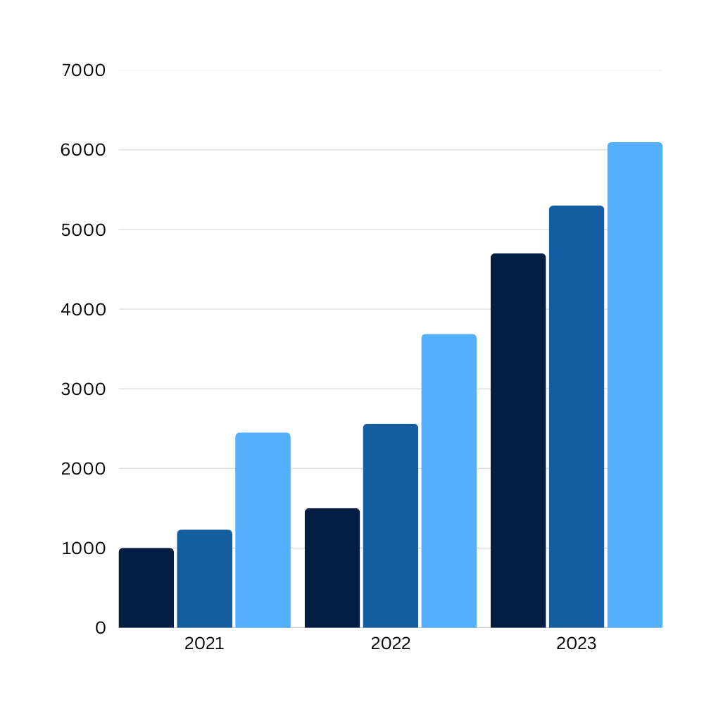
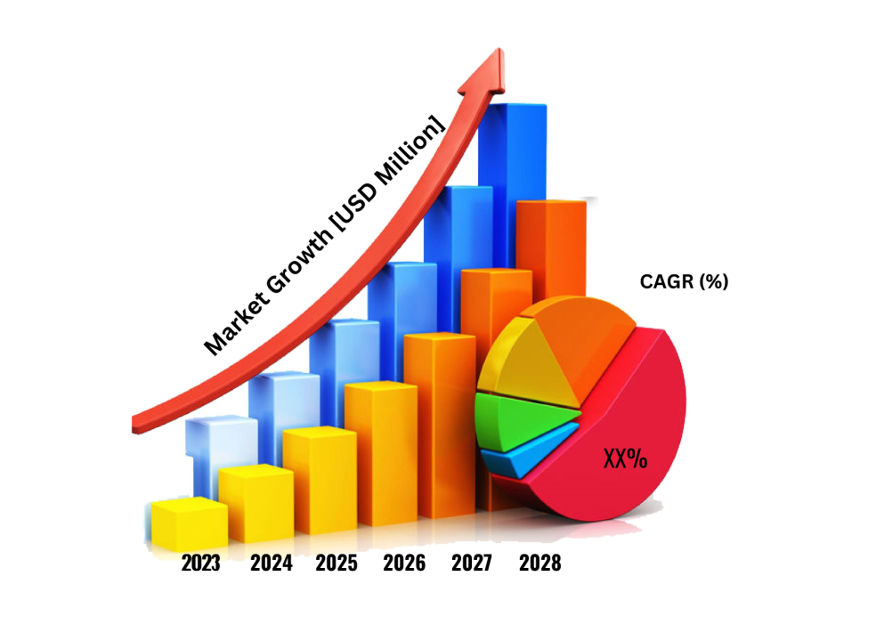
4. Market Analysis
Quick stats on market growth (e.g., $25 billion globally in 2023).
2. Growing need for reliable, fast roadside services with the increase in car owners..

Slide 14

5. OUR BUSINESS MODEL
Revenue sources: service fees, premium subscriptions, partnerships.
2. Key partnerships: mechanics, parts suppliers, insurers.

Slide 15


6.Getting the Word Out
1.Pre-launch: Social media buzz, influencer partnerships.
2.Launch: App Store optimization, referral program.
3.Post-launch: Continuous engagement, reviews, and partnerships.

Slide 16
TIMELINE
Ongoing updates & scaling
Launch & initial promotion
Development & testing
4
Market research & design
3
2
1

Slide 17

FINANCIAL PLAN AND FEASIBILITY
1
Initial investment requirements for development, marketing, and partnerships.
2
Profitability forecast in 2–3 years, with steady revenue growth.

Slide 18



ON SPOT AUTOCARE: YOUR RELIABLE DRIVING COMPANION
“Bringing trusted roadside help to drivers anywhere, anytime, so you can drive with peace of mind.”

Slide 19

Any Questions?

Slide 20

Thank You

